Slide 1
Real Estate Regression Project
Karol Kusmierczuk
BAN-6025-A
Fall 2024

Slide 2
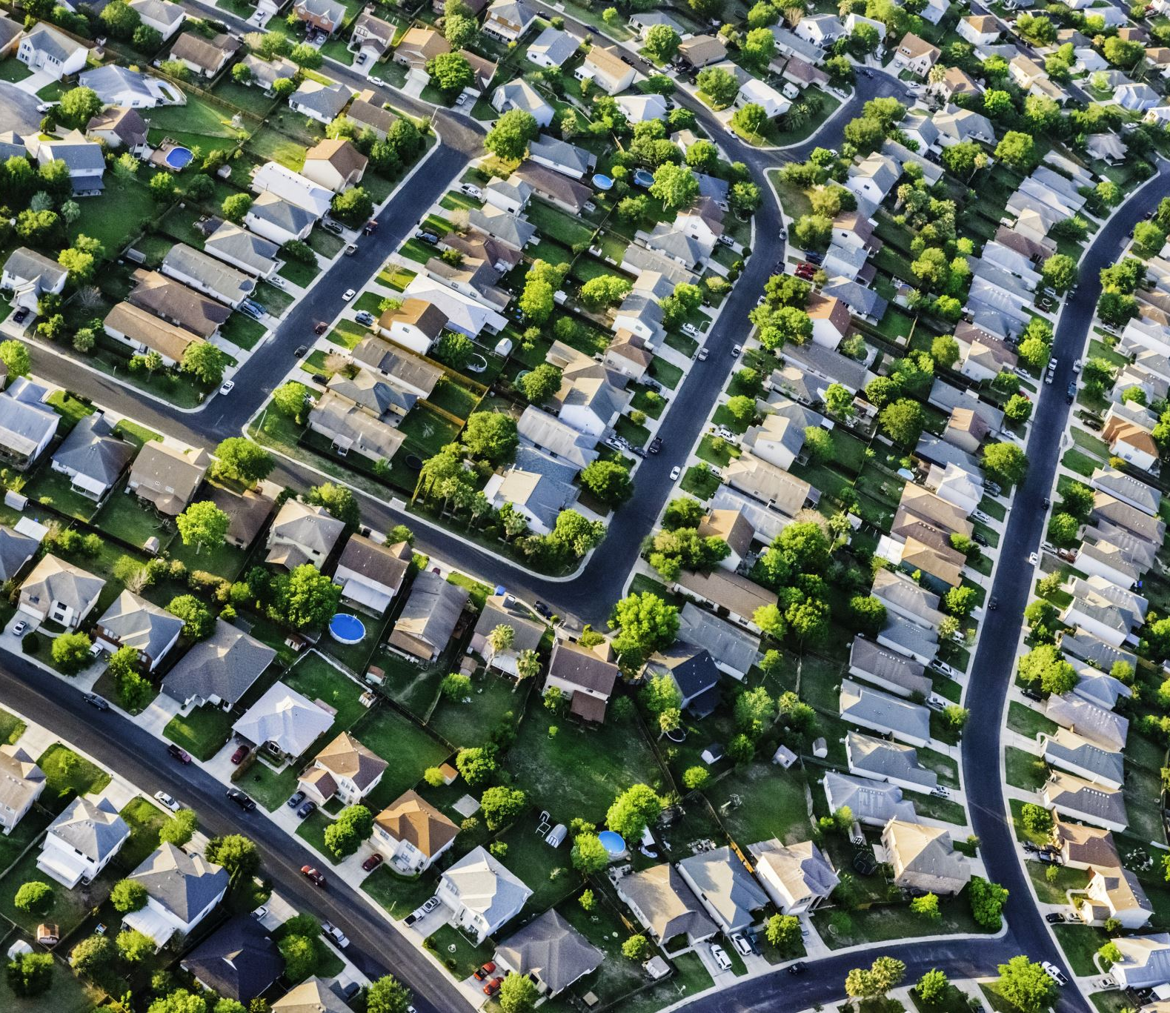
Overview of Data
1,460 Houses
Sold from 2006 to 2010
Data provides 27 details about home attributes, amenities, and property features
Notes:
The data contains information on 1,460 houses that were sold from 2006 to 2010. The data contains 27 details about the houses’ attributes, amenities, and property features. Some examples of these details include the square footage, sale price, the year the house was built, the year the house was remodeled, the number of fireplaces, if there is a pool, and if the house has central air.

Slide 3
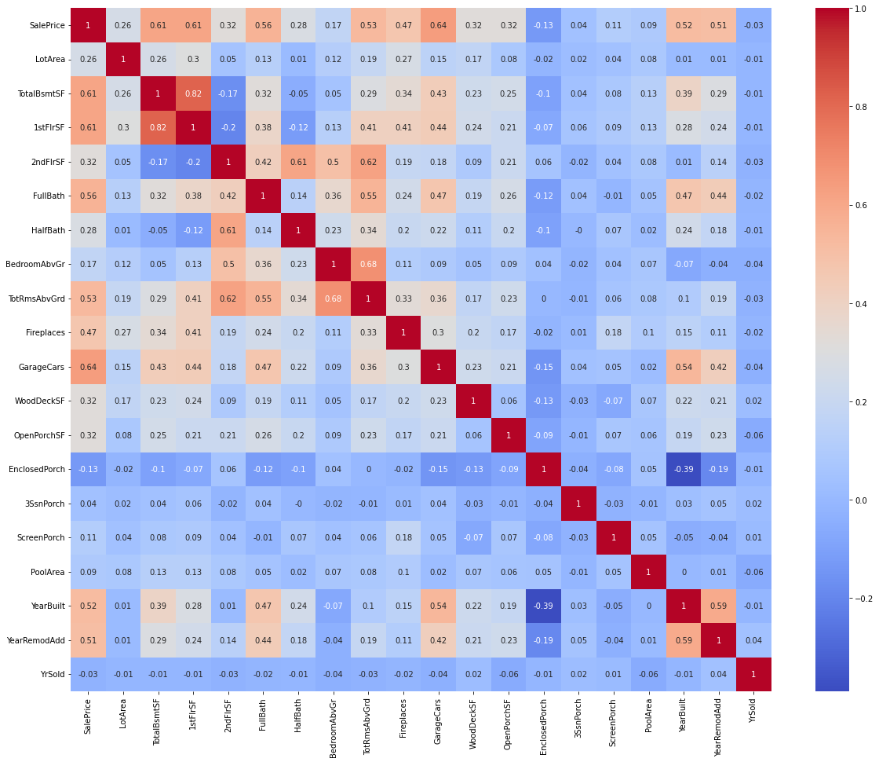
Variable
Relationships
Correlation heat map showing relationships between variables in the original data
Notes:
Here is a correlation heat map of all the variables in the original dataset. The heatmap foreshadows which of the variables will be significant in determining the sales price through the variables with a high correlation with sales price. The top three variables are GarageCars, 1stFlrSF, and TotalBsmtSF, which have a correlation above 0.60.

Slide 4

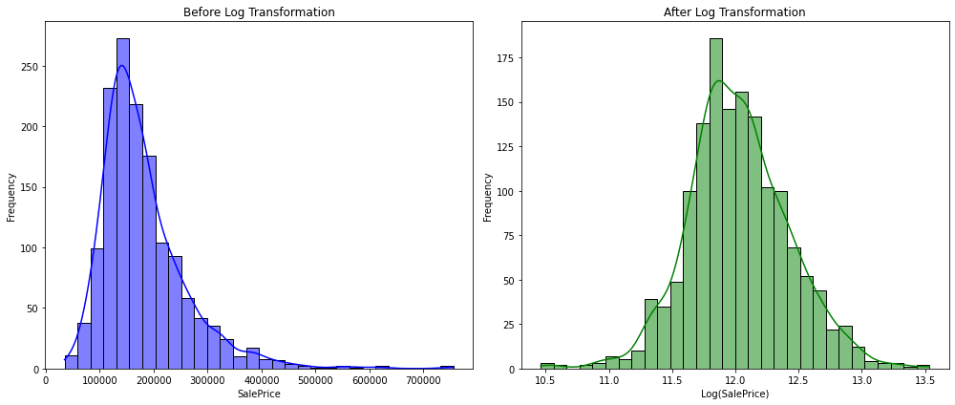
Preparing the Data
Converted categorical data into dummy variables
Applied a log transformation to SalePrice
Notes:
Categorical data such as the kitchen quality, if the driveway was paved, or if the house has central air was converted into dummy variables to include them in the regression model. Regression models cannot be trained on data that is text, so these variables needed to be turned into numbers. A log transformation was applied to SalePrice to normalize the distribution and improve model accuracy since it was skewed to the right as seen in blue in the graphs.

Slide 5
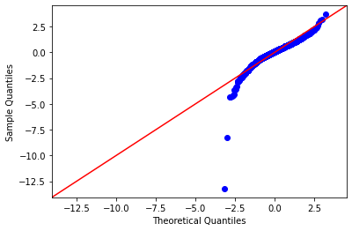
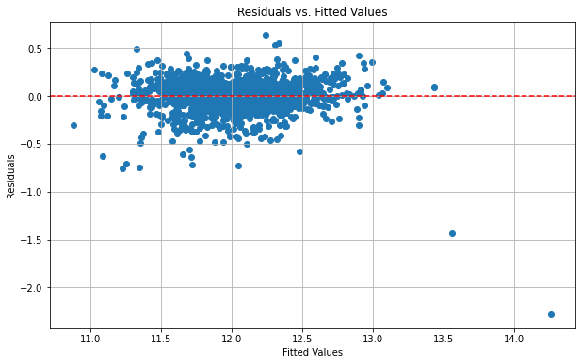
Regression Model
R-squared: 0.813
Adjusted R-squared: 0.811
Q-Q plot
Mainly straight
Normally distributed
Residuals
Points randomly around zero
No heteroscedasticity
Notes:
The R-squared for this model is relatively high as it is 0.813, which means these variables will be good indicators of the final sale price and that 81% of variability in the sale price can be explain by the variables in the final model. The Q-Q plot shows that the data is mostly normally distributed with some deviation. The residuals graph further supports the model being good as it shows that there are points randomly scattered around zero, which means the model captures most of the relationships between the variables. It also shows no heteroscedasticity, which also indicates a good model.

Slide 6
Regression Model Criteria
High R-square
X-variables significant at the 5% level
No multicollinearity
All assumptions satisfied as seen with residuals
Notes:
This is a good regression model since it meets the following criteria:
High R-square with 0.813
X-variables significant at the 5% level - almost all are near 0, meaning they are very significant
No multicollinearity since VIF levels are below 5
All assumptions satisfied as seen with residuals in the previous slide, which show there is no

Slide 7
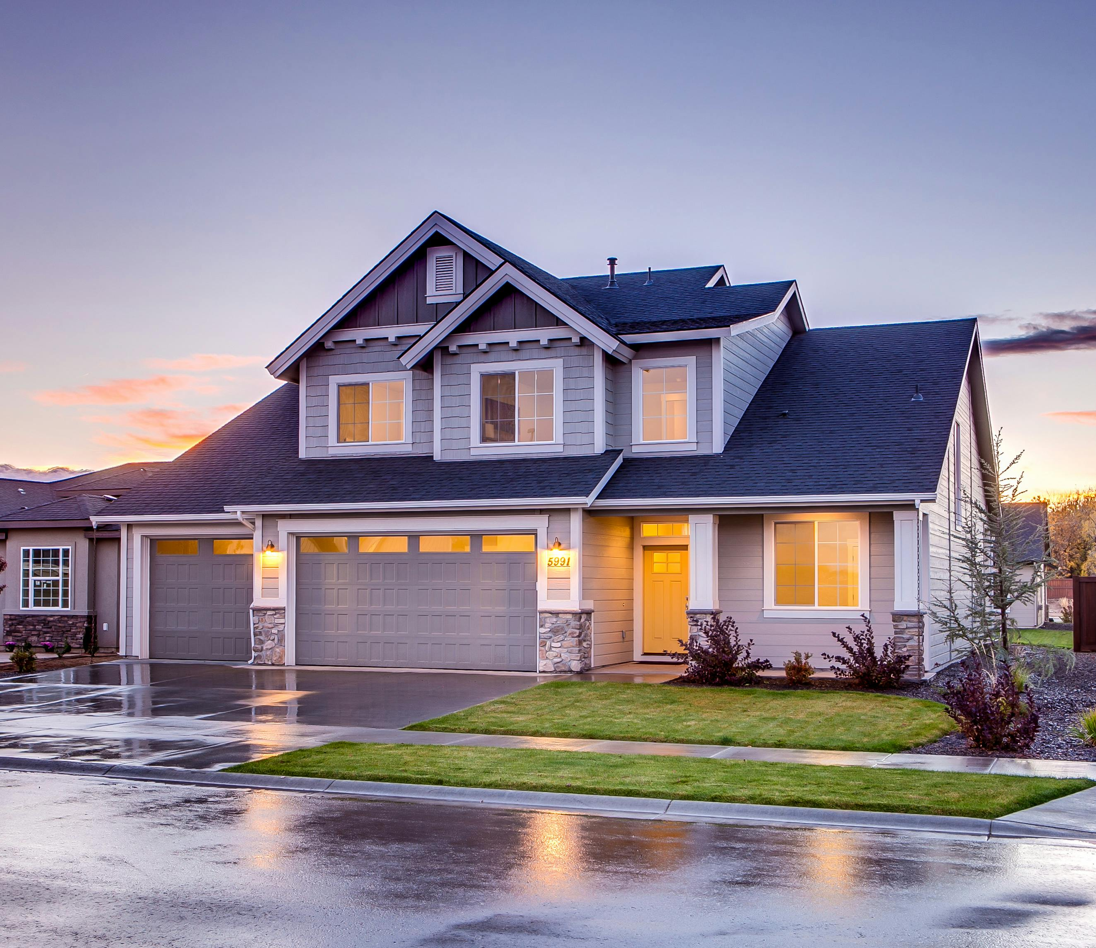
Investor Recommendations
Variables that help increase the value of the house:
High square footage for the basement, 1st and 2nd floors, screened porch, and wooden deck
Fully/partially paved driveway
Central air conditioning
Excellent kitchen quality
Garage capacity
Year remodeled
Number of fireplaces
Notes:
These are the variables that help increase the value of the house and things that the investor should consider:
High square footage – larger square footage in the basement, 1st and 2nd floors, screened porch, and wooden deck will increase value, or at least having these areas in the house will help
Paved driveway – fully or partially paved driveways increase value
Central air conditioning – having central air conditioning
Excellent kitchen quality – having an excellent-quality kitchen will increase the value while any other quality will decrease the value
Garage capacity – more garage spaces to fit more cars
Year remodeled – the year the house was remolded or updated, higher value for more recent changes
Number of fireplaces – higher number of fireplaces will increase the value

Slide 8
Predicted Sales Prices
Notes:
Using the regression model from the previous slides, these are the predicted prices for the houses up for sale based on the provided data.

